Slide 1
Numerical Integration
Simpson’s Rule

Slide 2
Another Estimate?!
Assume we are trying to estimate the integral of the following data:
How well will the Riemann Sum or Trapezoidal Sum work with this data?

Slide 3

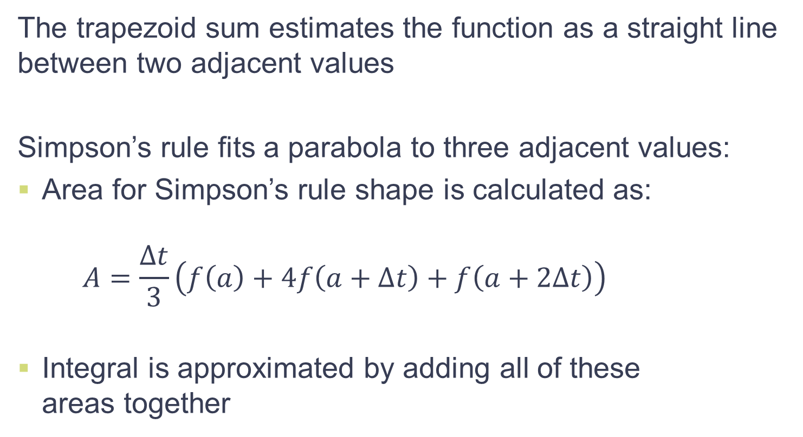
Simpson’s Rule
The trapezoid sum estimates the function as a straight line between two adjacent values
Simpson’s rule fits a parabola to three adjacent values:
Area for Simpson’s rule shape is calculated as:
$$A=\frac{∆t}{3}\left(f\left(a\right)+4f\left(a+∆t\right)+f\left(a+2∆t\right)\right)$$
Integral is approximated by adding all of these areas together
I have a rule?!

Slide 4
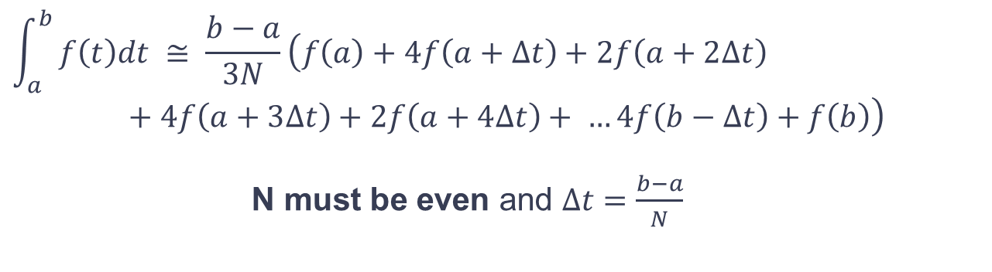
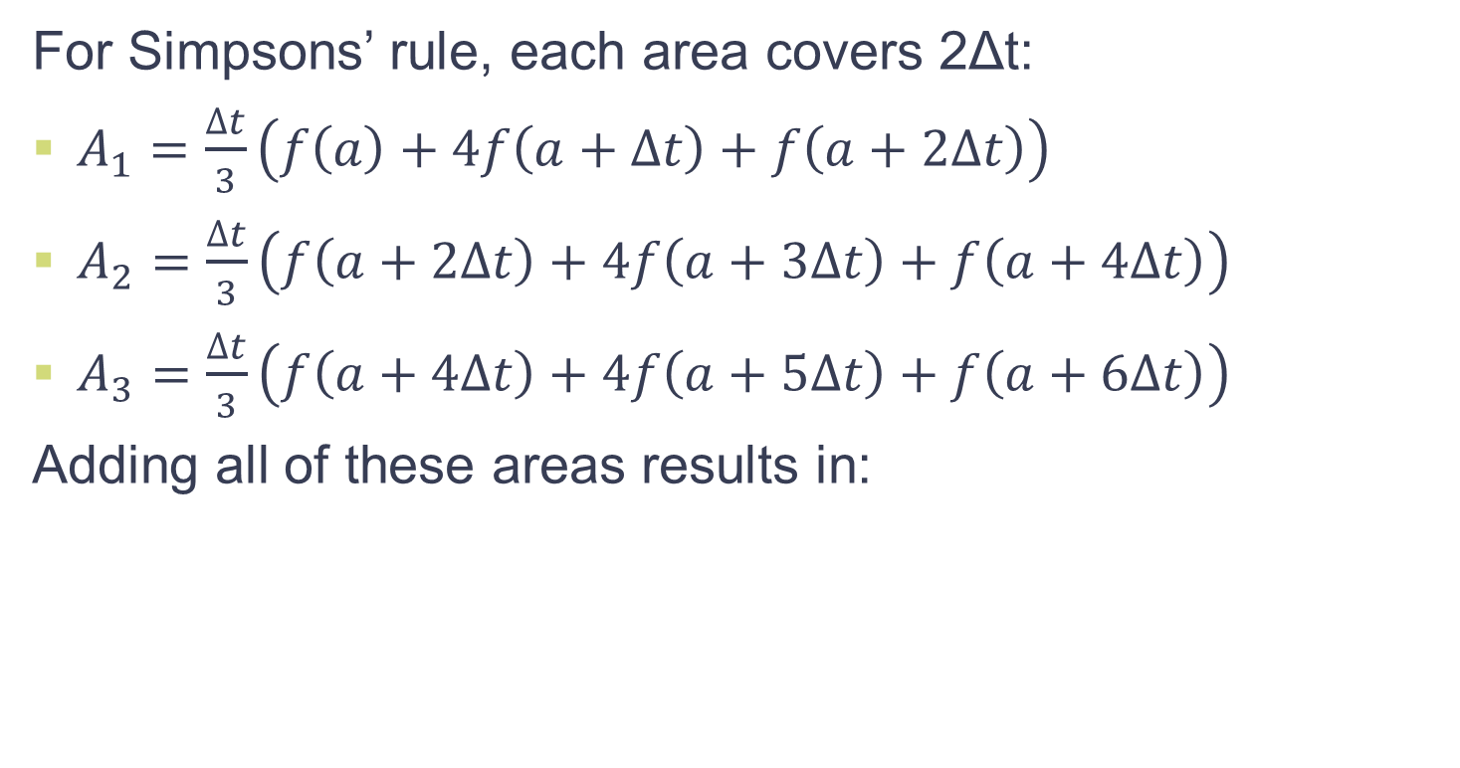
Simpson’s Rule
For Simpsons’ rule, each area covers 2Δt:
$A_{1}=\frac{∆t}{3}\left(f\left(a\right)+4f\left(a+∆t\right)+f\left(a+2∆t\right)\right)$
$A_{2}=\frac{∆t}{3}\left(f\left(a+2∆t\right)+4f\left(a+3∆t\right)+f\left(a+4∆t\right)\right)$
$A_{3}=\frac{∆t}{3}\left(f\left(a+4∆t\right)+4f\left(a+5∆t\right)+f\left(a+6∆t\right)\right)$
Adding all of these areas results in:
$$\int_{a}^{b}{f\left(t\right)dt ≅ \frac{b−a}{3N}}\left(f\left(a\right)+4f\left(a+∆t\right)+2f\left(a+2∆t\right)+4f\left(a+3∆t\right)+2f\left(a+4∆t\right)+ …4f\left(b−∆t\right)+f\left(b\right)\right)$$
N must be even and $∆t=\frac{b−a}{N}$

Slide 5
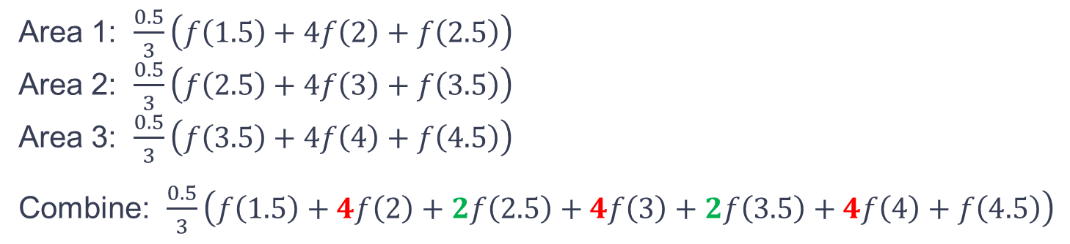
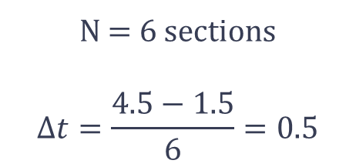
Simpson’s Rule
N = 6 sections
$$∆t=\frac{4.5−1.5}{6}=0.5$$
Simpson’s Rule estimate will always follow this pattern:
1-4-2-4-2-…-2-4-1
Simpson’s Rule estimate will always follow this pattern:
1-4-2-4-2-…-2-4-1
Area 1: $\frac{0.5}{3}\left(f\left(1.5\right)+4f\left(2\right)+f\left(2.5\right)\right)$
Area 2: $\frac{0.5}{3}\left(f\left(2.5\right)+4f\left(3\right)+f\left(3.5\right)\right)$
Area 3: $\frac{0.5}{3}\left(f\left(3.5\right)+4f\left(4\right)+f\left(4.5\right)\right)$
Combine: $\frac{0.5}{3}\left(f\left(1.5\right)+4f\left(2\right)+2f\left(2.5\right)+4f\left(3\right)+2f\left(3.5\right)+4f\left(4\right)+f\left(4.5\right)\right)$

Slide 6
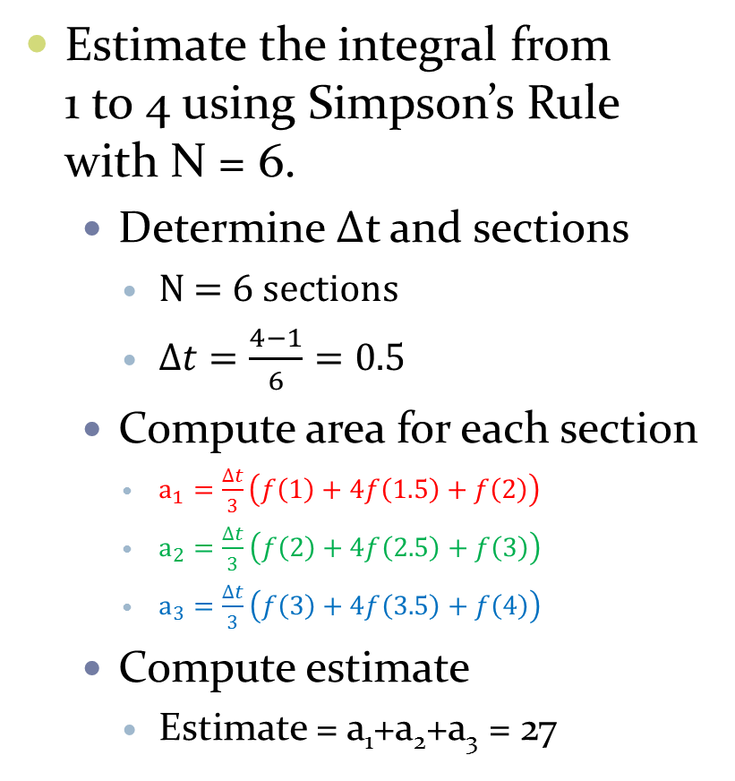
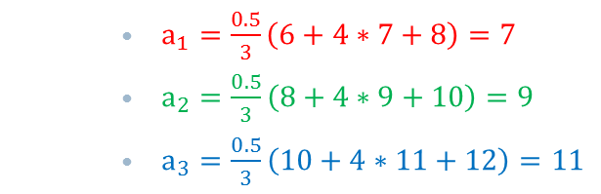
Simpson’s Rule Example
Estimate the integral from 1 to 4 using Simpson’s Rule with N = 6.
Determine Δt and sections
N = 6 sections
$∆t=\frac{4−1}{6}=0.5$
Compute area for each section
$a_{1}=\frac{∆t}{3}\left(f\left(1\right)+4f\left(1.5\right)+f\left(2\right)\right)$
$a_{2}=\frac{∆t}{3}\left(f\left(2\right)+4f\left(2.5\right)+f\left(3\right)\right)$
$a_{3}=\frac{∆t}{3}\left(f\left(3\right)+4f\left(3.5\right)+f\left(4\right)\right)$
Compute estimate
Estimate = a₁+a₂+a₃ = 27
$a_{1}=\frac{0.5}{3}\left(6+4∗7+8\right)=7$
$a_{2}=\frac{0.5}{3}\left(8+4∗9+10\right)=9$
$a_{3}=\frac{0.5}{3}\left(10+4∗11+12\right)=11$
x | f(x) | x | f(x)
1 | 6 | 3 | 10
1.5 | 7 | 3.5 | 11
2 | 8 | 4 | 12
2.5 | 9 | 4.5 | 13

Slide 7
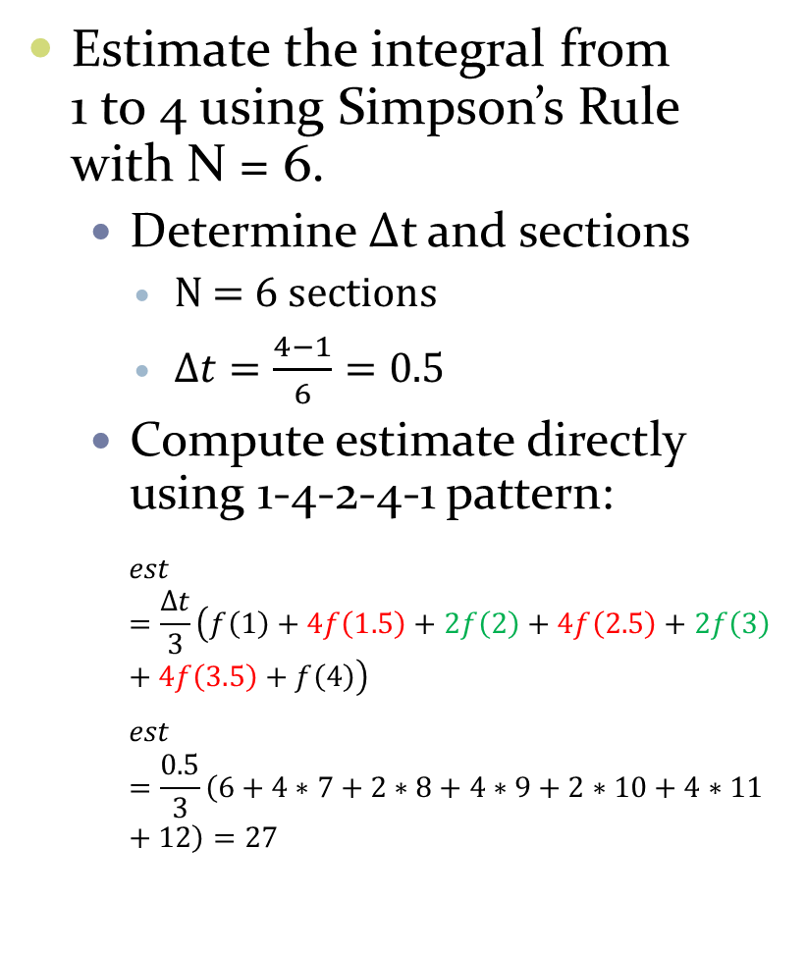
Simpson’s Rule Example
Estimate the integral from 1 to 4 using Simpson’s Rule with N = 6.
Determine Δt and sections
N = 6 sections
$∆t=\frac{4−1}{6}=0.5$
Compute estimate directly using 1-4-2-4-1 pattern:
$$est=\frac{∆t}{3}\left(f\left(1\right)+4f\left(1.5\right)+2f\left(2\right)+4f\left(2.5\right)+2f\left(3\right)+4f\left(3.5\right)+f\left(4\right)\right)$$
$$est=\frac{0.5}{3}\left(6+4∗7+2∗8+4∗9+2∗10+4∗11+12\right)=27$$
x | f(x) | x | f(x)
1 | 6 | 3 | 10
1.5 | 7 | 3.5 | 11
2 | 8 | 4 | 12
2.5 | 9 | 4.5 | 13

Slide 8
Example 1
Use Simpson’s Rule to find the integral of the data shown below.
Time | Data
0.0 | 1.0
0.5 | 1.6
1.0 | 2.7
1.5 | 4.4
2.0 | 7.4
2.5 | 12.2
3.0 | 20

Slide 9
Example 2
Use Simpson’s Rule to find the integral of the data shown below.

Slide 10
Real-Time Integration

Slide 11

Integrating in Real-Time Simpson Sum Approximation
Wait for first three measurements, v(t_{o}), v(t₁), v(t₂). Compute position estimate:
pos_est$\text{(}\text{t}\text{2}\text{)}$ = pos_est$\text{(}\text{t}\text{0}\text{)}$ + $\frac{∆t}{3}\left[\text{v}\text{(}\text{to}\text{)+4}\text{v}\text{(}\text{t}\text{1}\text{)}\text{+}\text{v}\text{(}\text{t}\text{2}\text{)}\right]$
OUTPUT
INPUT
OPERATION

Slide 12
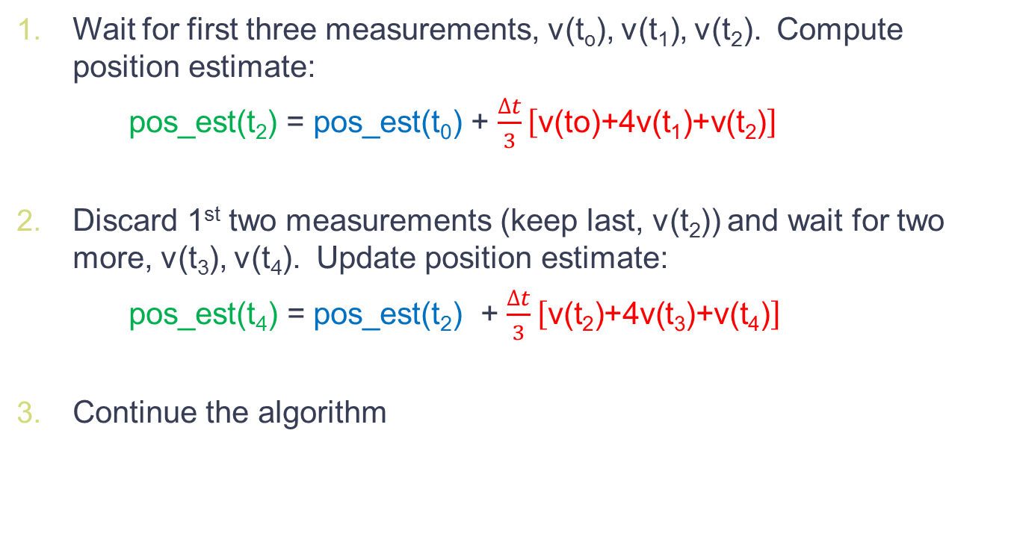
Integrating in Real-Time Simpson Sum Approximation
Wait for first three measurements, v(t_{o}), v(t₁), v(t₂). Compute position estimate:
pos_est$\text{(}\text{t}\text{2}\text{)}$ = pos_est$\text{(}\text{t}\text{0}\text{)}$ + $\frac{∆t}{3}\left[\text{v}\text{(}\text{to}\text{)+4}\text{v}\text{(}\text{t}\text{1}\text{)}\text{+}\text{v}\text{(}\text{t}\text{2}\text{)}\right]$
Discard 1st two measurements (keep last, v(t₂)) and wait for two more, v(t₃), v(t₄). Update position estimate:
pos_est(t₄) = pos_est(t₂) + $\frac{∆t}{3}\left[\text{v}\text{(}\text{t}\text{2}\text{)+4}\text{v}\text{(}\text{t}\text{3}\text{)+}\text{v}\text{(}\text{t}\text{4}\text{)}\right]$
Continue the algorithm

Slide 13
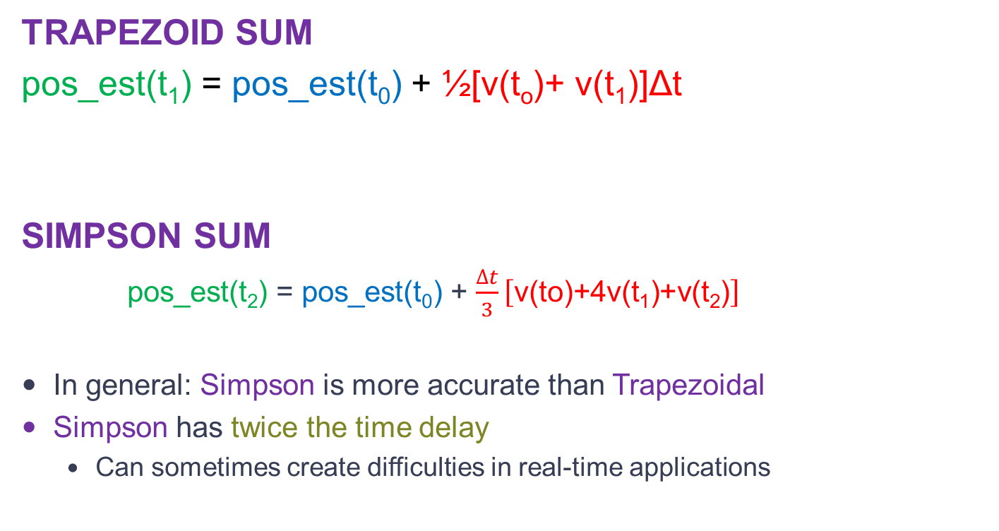
Integrating in Real-Time Which Method?
TRAPEZOID SUM
pos_est(t₁) = pos_est(t₀) + ½[v(t_{o})+ v(t₁)]Δt
SIMPSON SUM
pos_est$\text{(}\text{t}\text{2}\text{)}$ = pos_est$\text{(}\text{t}\text{0}\text{)}$ + $\frac{∆t}{3}\left[\text{v}\text{(}\text{to}\text{)+4}\text{v}\text{(}\text{t}\text{1}\text{)}\text{+}\text{v}\text{(}\text{t}\text{2}\text{)}\right]$
In general: Simpson is more accurate than Trapezoidal
Simpson has twice the time delay
Can sometimes create difficulties in real-time applications

Slide 14

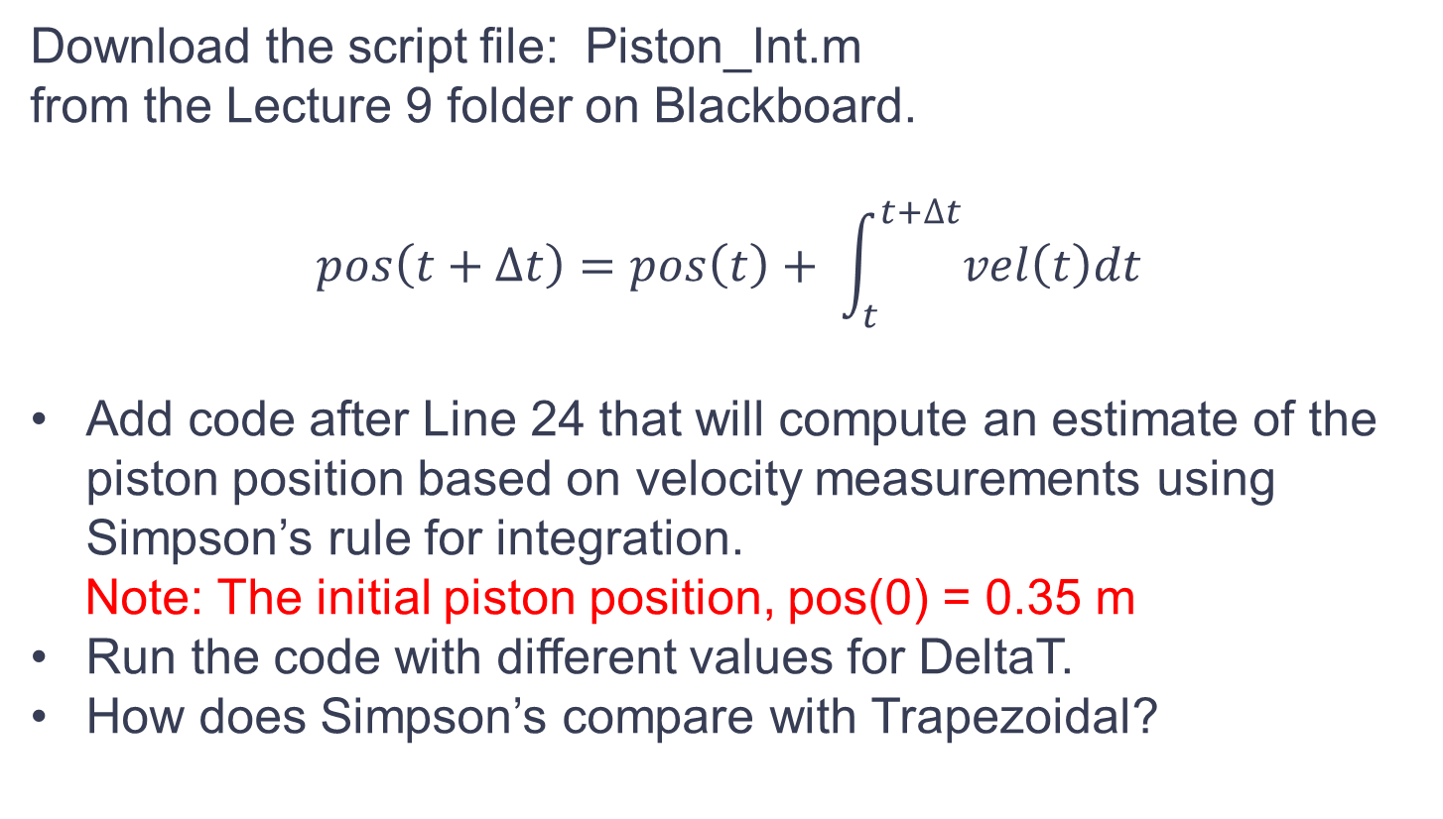
Crankshaft
Download the script file: Piston_Int.m
from the Lecture 9 folder on Blackboard.
$$pos\left(t+∆t\right)=pos\left(t\right)+ \int_{t}^{t+∆t}{vel\left(t\right)dt}$$
Add code after Line 24 that will compute an estimate of the piston position based on velocity measurements using Simpson’s rule for integration.
Note: The initial piston position, pos(0) = 0.35 m
Run the code with different values for DeltaT.
How does Simpson’s compare with Trapezoidal?

